Slide 1
CS 419: Production Rendering Geometric Modeling with Implicits
Eric Shaffer

Slide 2
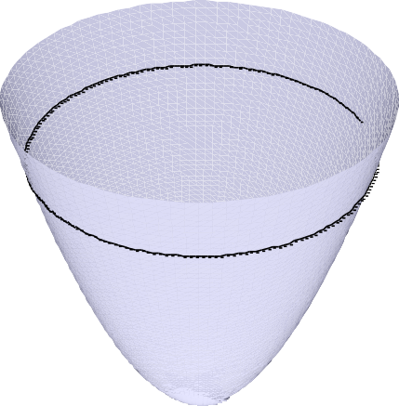
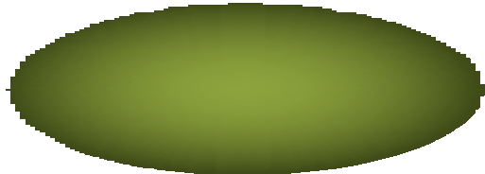


Implicit Surfaces
◉ Real function f (x,y,z)
◉ Classifies points in space
◉ CAGD: inside f < 0, outside f > 0
◉ Surface f⁻¹(0): Manifold if zero is a regular value of f
f=0
1
f < 0
f = 0
f > 0
(0,0)
f > 0 f < 0
Circle example
f(x,y) = x² + y² – 1
z = f(x,y)

Slide 3
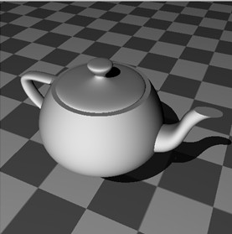
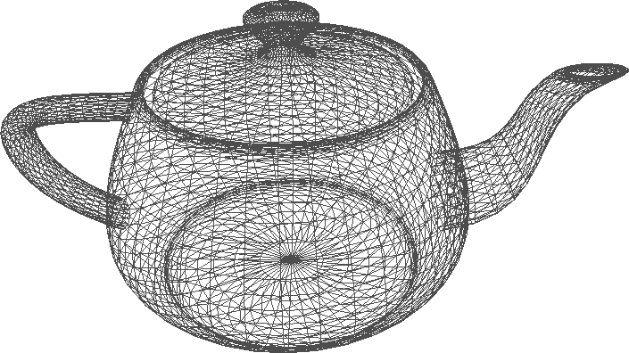
Why Use Implicits?
◉ versus polygons
◉ smoother
◉ compact, fewer higher-level primitives
◉ downside: harder to real-time render
◉ versus parametric patches
◉ easier to blend
◉ no topology problems
◉ lower degree
◉ easier to ray trace
◉ well defined interior  downside: harder to parameterize
◉ What’s an example of a parametric patch?

Slide 4

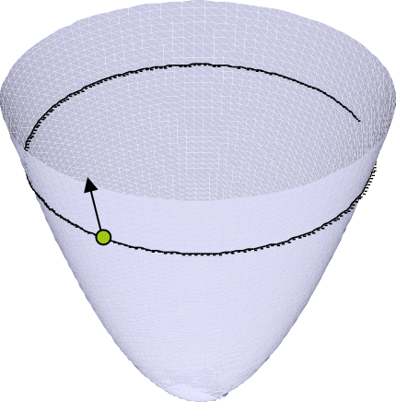
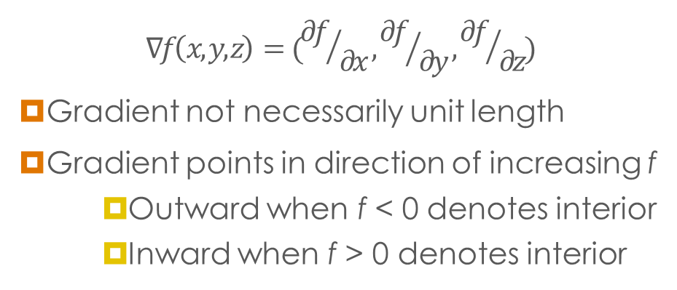
Surface Normals
1
f < 0
f > 0
f=0
(0,0)
◉ Surface normal usually gradient of function
$$∇f\left(x,y,z\right)=({∂f}/{∂x},{∂f}/{∂y},{∂f}/{∂z})$$
◉ Gradient not necessarily unit length
◉ Gradient points in direction of increasing f
◉ Outward when f < 0 denotes interior
◉ Inward when f > 0 denotes interior
Circle example f(x) = x² + y² – 1 x = (x,y)
◉ How do you perform ray intersections?
z = f(x,y)

Slide 5
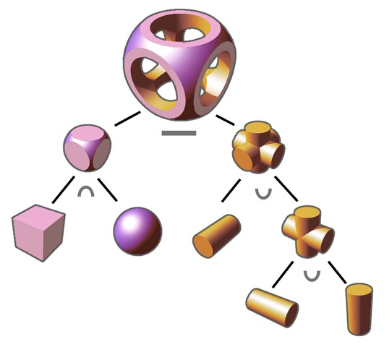
CSG:
Constructive Solid
Geometry
◉ Assume f < 0 inside
◉ CSG ops by min/max ops
◉ Union: min f,g
◉ Intersection: max f,g
◉ Complement: -f
◉ Subtraction: max f,-g
◉ Problem: C¹ discontinuity
◉ Can we smooth the blend crease?
◉ Anyone remember the technique?
f < 0
g < 0
f < 0
g < 0

Slide 6
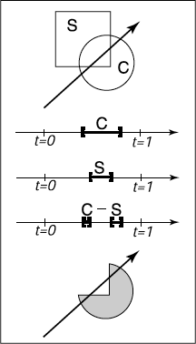
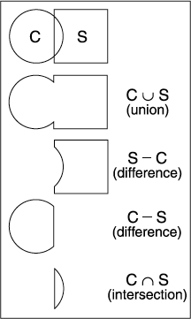
Ray Tracing CSG Objects
◉ Intersect the ray with each basic object
◉ Where are these object located in the tree?
◉ Each intersection generates an interval on the ray
◉ Perform the boolean operations on the ray
◉ Pro-tip: Work in parametric space, not world coordinates

Slide 7
Blending Implicits

Slide 8
Uses of Blobby Modelling
Organic forms and nonlinear shapes
Scientific modelling (electron orbitals, some medical imaging)
Muscles and joints with skin
Rapid prototyping
CAD/CAM solid geometry

Slide 9
How does it work?
Each point in space generates a field of force, which drops off as a function of distance from the point.
A blobby model is formed from the shells of these force fields, the implicit surface which they define in space.

Slide 10
How does it work? (Bourke 1997)
Several force functions work well. Examples:
“Blobby Molecules” - Jim Blinn
F(r) = a e^{-br2}
Here ‘b’ is related to the standard deviation of the curve, and ‘a’ to the height.

Slide 11
How does it work? (Bourke 1997)
Several force functions work well. Examples:
“Metaballs” - Blinn again (I think)
F(r) = { a(1- 3r² / b²) 0 <= r < b/3 { (3a/2)(1-r/b)² b/3 <= r < b { 0 b <= r
Here ‘a’ is a scaling factor and ‘b’ bounds the radius of effect.

